Slide 1
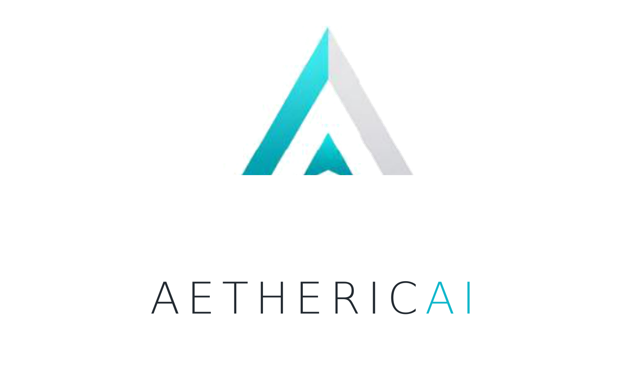

EXECUTIVE OVERVIEW | 2026
AI intelligence above your ERP.
Action across your supply chain.
AethericAI helps finance, operations and supply chain leaders turn fragmented ERP signals into predictions, decisions and governed execution.
CONNECT → DETECT → RECOMMEND → APPROVE → ACT
PART OF THE KMICRO ECOSYSTEM
FOUNDING LEADERSHIP
Microsoft-aligned enterprise delivery and ERP expertise
Amit Sachdev • Mazen Sadat
AETHERICAI • AN INTELLIGENCE LAYER, NOT AN ERP REPLACEMENT
01
Notes:
• AethericAI public site: https://aethericai.com/ and https://aethericai.com/aboutus/
• AethericAI connection to KMicro: https://www.linkedin.com/posts/nadeem-yusufaly-6923a045_digitalsop-supplychain-dynamics365-activity-7429960675986198528--dPJ
• Founding-leadership attribution naming Mazen supplied by requester; confirm formal co-founder designation before publication.

Slide 2
02 / THE PEOPLE BEHIND THE PLATFORM
Executive leadership & advisors
Technology, commercial execution and industry expertise — one connected team.
AMIT SACHDEV
YOUNG LEE
MAZEN SADAT
CEO
KMicro CEO · founding leadership
FOUNDER • CTO & CSO
Leads AethericAI platform architecture, technology direction and enterprise data systems.
CURRENTLY LISTED ON AETHERICAI.COM
MEHUL TANEJA
KIRAN KHALID
Head of Engineering
Director of Partnerships
Brings expertise across AI, cybersecurity, governance and trusted enterprise integration.
BORIS ZNEBEL
AANA KHAN
Director of Sales
Marketing Manager
Focuses on moving governed intelligence from ERP insight to auditable business actions.
ADDITIONAL TEAM & ADVISORY ROSTER • TITLES TO CONFIRM
SATWIK
Consultant
SHIKHA
Consultant
LinkedIn: linkedin.com/in/amitssachdev
OLEKSIY
Supply chain advisor
LOUIS
Supply chain advisor
AETHERICAI • DECISION INTELLIGENCE FOR SUPPLY CHAIN OPERATIONS
02
Notes:
• AethericAI official team: https://aethericai.com/aboutus/ (Young, Amit, Mehul, Kiran, Boris, Aana).
• Amit CTO & CSO from the user-provided AethericAI_AI_Security.pdf page 1, CTO & founder from the company website. LinkedIn requested: https://www.linkedin.com/in/amitssachdev/
• Mazen KMicro CEO: https://kmicro.com/kmicro-welcomes-kathleen-grabowski-as-new-chief-operating-officer/
• Satwik, Shikha, Oleks, Lui and Mazen as a founding leader were supplied by the requester; full names/roles and formal founder status require approval.

Slide 3
03 / AI-POWERED SUPPLY CHAIN ORCHESTRATION
ERP plans. AethericAI orchestrates.
From disconnected reports to coordinated, explainable action across finance and operations.
01
02
03
04
ERP SYSTEM OF RECORD
→
AETHERICAI PREDICT
→
SCENARIO & DECISION
→
GOVERNED EXECUTION
Orders · inventory · financials
Sense change · forecast risk
Evaluate trade-offs · quantify impact
Approval gates · ERP write-back
D365 · SAP · Sage · Odoo
What happens next?
What should we do?
Who approves and acts?
REAL-TIME SIGNALS • CONNECTED PLANNING • NEXT-BEST ACTION • HUMAN OVERSIGHT
Industry context
Supply chain orchestration synchronizes planning, response and execution across functions.
AETHERICAI • DECISION INTELLIGENCE FOR SUPPLY CHAIN OPERATIONS
03
Notes:
• AethericAI product workflow: https://aethericai.com/platform/
• AethericAI home (Report / Predict / Orchestrate): https://aethericai.com/
• Kinaxis industry definition paraphrased, not copied: https://www.kinaxis.com/en/supply-chain-orchestration and https://www.kinaxis.com/en/about.
• AethericAI Predict is the deck’s requested label for predictive capabilities, not independently verified as a separate product name.

Slide 4
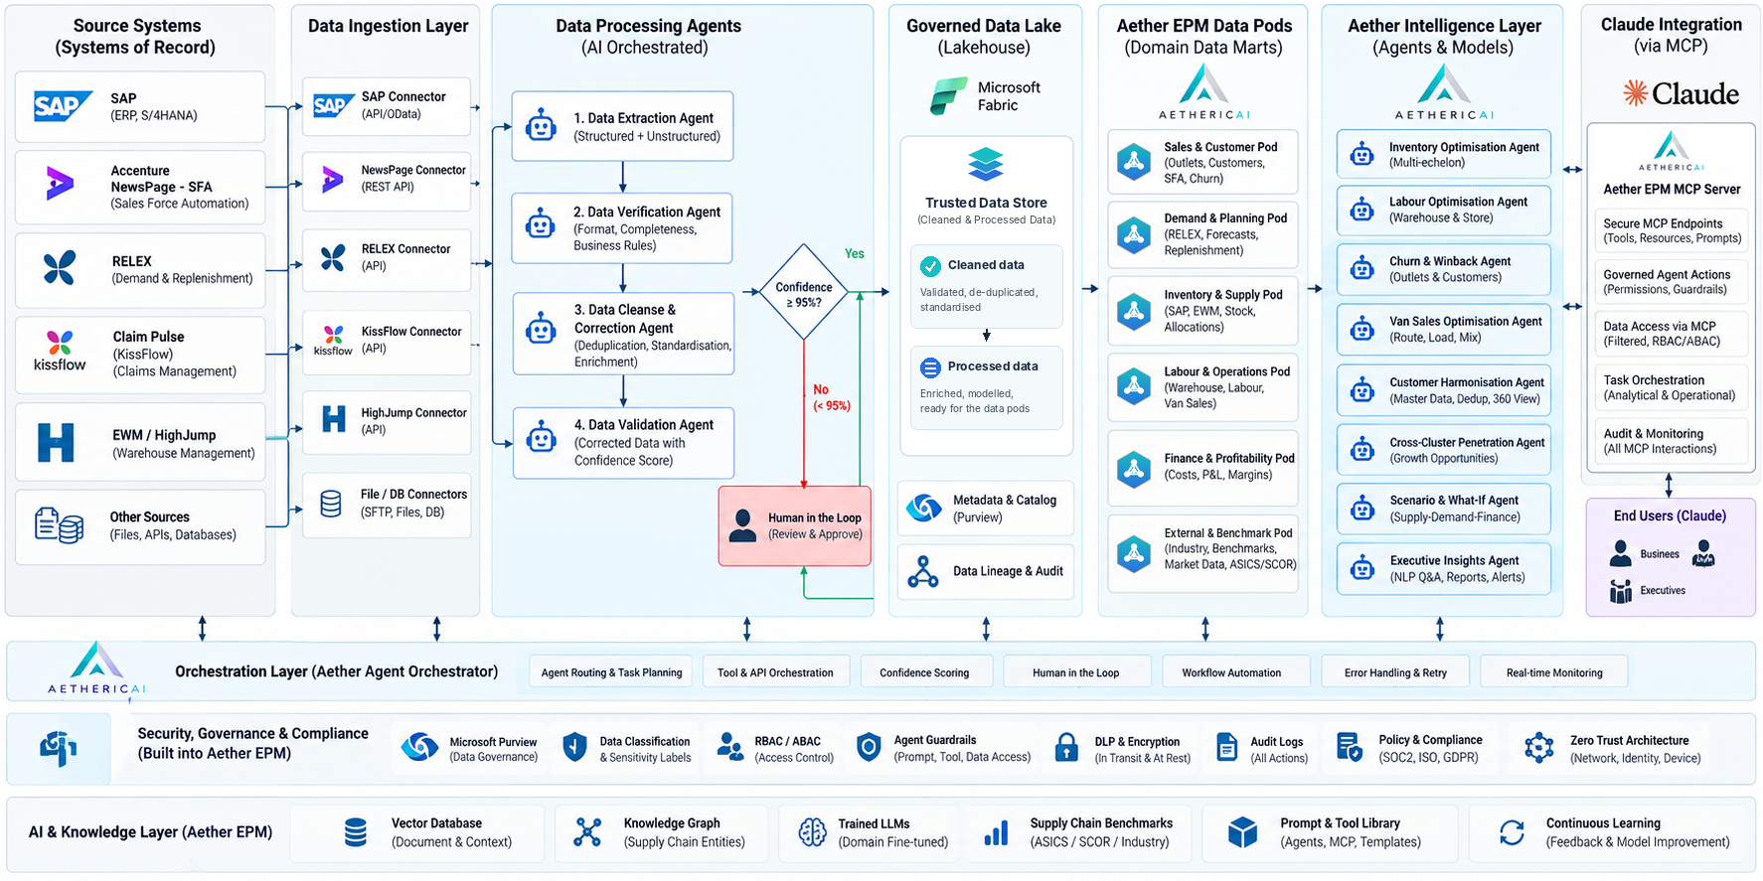
04 / PROPRIETARY ARCHITECTURE / 1 OF 2
Aether EPM enterprise architecture
Notes:
• Placeholder intentionally blank at requester’s direction. Suggested source for context only: https://aethericai.com/platform/ ; do not present this as an endorsed architecture diagram before replacement.

Slide 5
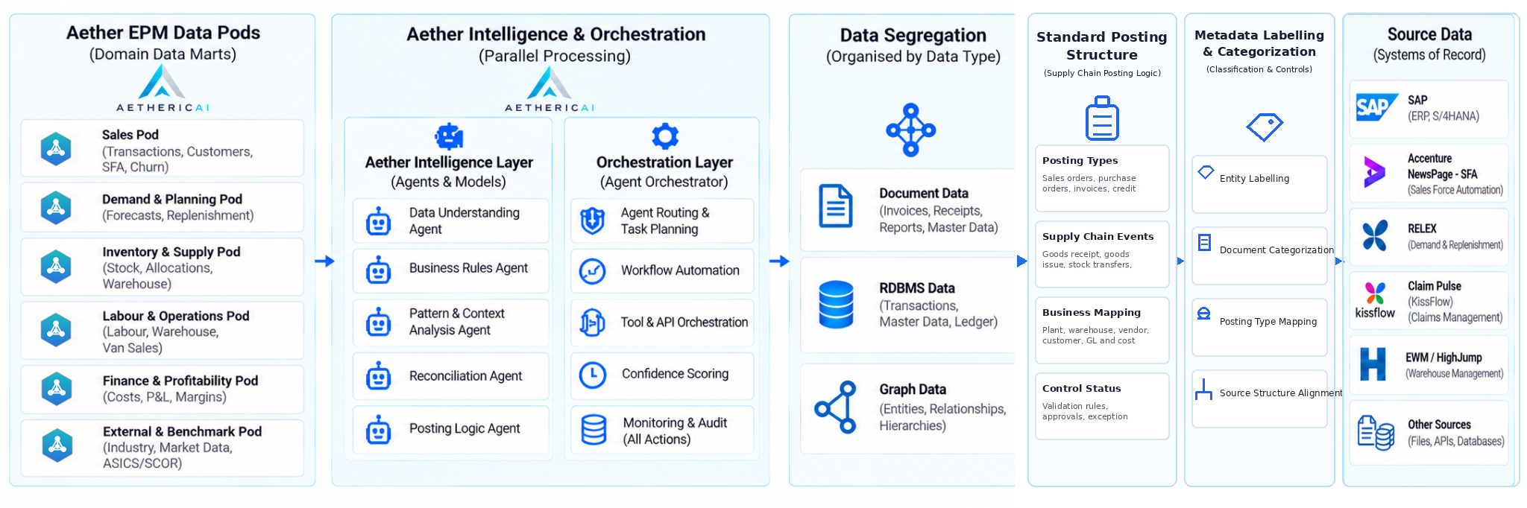
05 / PROPRIETARY ARCHITECTURE / 2 OF 2
Aether EPM intelligence & orchestration model
Original platform flow, with Standard Posting Structure integrated into the main architecture.
05
Notes:
• Placeholder intentionally blank at requester’s direction. Current site outlines Connect, Detect, Recommend, Approve, Act: https://aethericai.com/platform/ .
• Security lifecycle in supplied reference PDF: ingest/label, retrieve/ground, reason/validate, execute/audit.

Slide 6
06 / AGENT EXPERIENCE & ORCHESTRATION
One orchestrator. Two agent families. Every channel.
USER EXPERIENCE
AETHER AGENT ORCHESTRATOR
DATA & TOOLS
Identity • RBAC • Intent routing • Task planning • Scheduler • MCP / API tools
ERP / APIs / Databases
Web portal
Browser / online users
Vector DB / Knowledge graph
Mobile app
AETHERIC AGENTS
CUSTOM AGENTS
iOS / Android teams
Data understanding & profiling
Inventory optimization
Azure OpenAI & AI Search
Internal tools
Enterprise applications
Business rules & policy checks
Demand planning / scenarios
Approved business actions
Reconciliation & validation
Finance analysis / use cases
AZURE NOTIFICATIONS & REAL-TIME UPDATES
Event Grid
Notification Hubs
SignalR Service
Comm. Services
Event routing
Mobile push
Live web updates
Email / SMS option
06

Slide 7
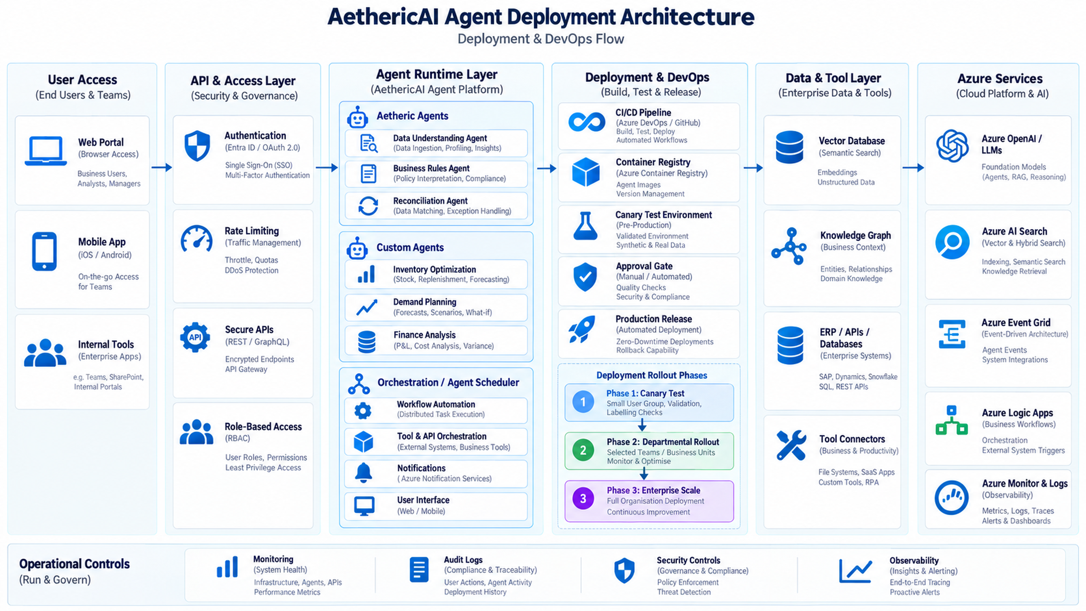

Slide 8
08 / SELECTED EXPERIENCE
Customer impact & project portfolio
CIRBA SOLUTIONS | BATTERY RECYCLING
NEW BALANCE
D365 Finance & Operations • S&OP forecasting • metal accounting • warehouse optimization
Footwear
Project scope / outcome: pending approval
+20%
–50%
+25%
HOME HARDWARE
Home improvement retail
FORECASTED REVENUE
FORECASTED INVENTORY TOUCHES
FORECASTED CASH FLOW
Project scope / outcome: pending approval
Predictive operations made previously unseen revenue and operational inefficiencies visible.
HENRY’S CAMERAS
Camera & imaging retail
Source: AethericAI case study. Figures described on the site as forecasted outcomes; individual results vary.
Project scope / outcome: pending approval
AETHERICAI • DECISION INTELLIGENCE FOR SUPPLY CHAIN OPERATIONS
08
Notes:
• Cirba Solutions public customer story: https://aethericai.com/resources/case-studies/materials-recycling/ ; site header and homepage identify the results as forecasted.
• The case page has some internal wording inconsistencies in its body; using the three top-line ROI metrics and the explicit homepage caveat.
• New Balance, Home Hardware and Henry’s Cameras were supplied by requester; no public AethericAI evidence located for project scopes, relationship or results.

Slide 9





09 / STRATEGIC ECOSYSTEM
Alliances, platforms & channels
Microsoft
ECOSYSTEM
Azure • Fabric • Foundry • Dynamics 365 • Entra ID • Purview
Technology alignment confirmed in AethericAI platform materials.
Consulting
Technology solutions
Cloud & IT solutions
Solutions integration
Technology solutions
RELATIONSHIP STATUS
Alliance names supplied for this presentation. Confirm partnership status, approved logo use and joint go-to-market language before external release.
AETHERICAI • DECISION INTELLIGENCE FOR SUPPLY CHAIN OPERATIONS
09
Notes:
• AethericAI Microsoft technology alignment: https://aethericai.com/platform/ and https://aethericai.com/aboutus/
• Additional company names supplied by the requester; individual relationship status requires verification.
• Logos on this slide are editable branded wordmark treatments, not exact corporate vector assets. Replace with brand-approved official artwork before publication.

Slide 10
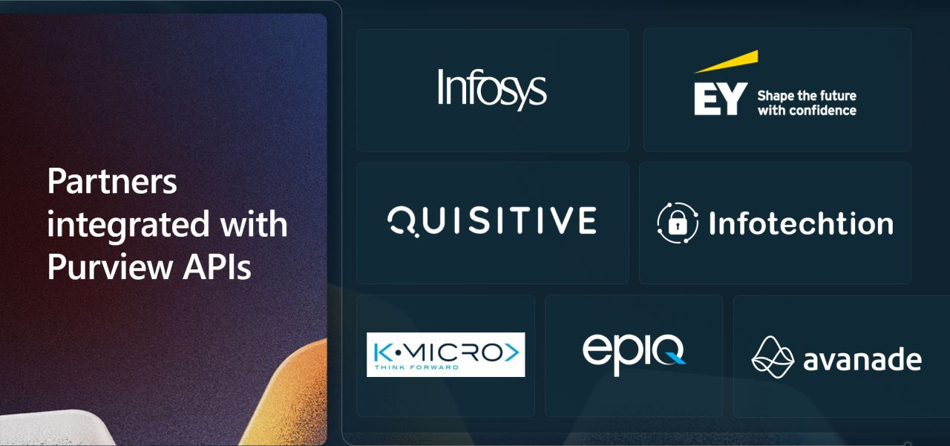
10 / MILESTONE | MICROSOFT BUILD 2025
KMicro × Microsoft: Purview SDK milestone
Microsoft Build 2025 • KMicro featured among partners integrated with Purview APIs.
BUILD 2025
A real partner
showcase
KMicro was featured among companies integrated with Microsoft Purview APIs.
BEHIND THE MILESTONE
Arpitha Dhanapathi and the KMicro delivery team played a key role in the Microsoft Purview SDK integration initiative.
PURVIEW SDK
AETHERICAI • DECISION INTELLIGENCE FOR SUPPLY CHAIN OPERATIONS
10
Notes:
• Primary source (Amit Sachdev): https://www.linkedin.com/posts/amitssachdev_as-we-wrap-up-a-very-successful-dynamicscon-ugcPost-7330685677136687104-qjv9/
• The post identifies the location as Microsoft Build in Seattle, describes public preview of Purview SDK, calls KMicro one of six globally integrated partners, and thanks Arpitha Dhanapathi (Microsoft).
• AethericAI post explicitly dates Purview SDK to Build 2025: https://www.linkedin.com/posts/aethericai_agenticai-aisecurity-microsoftpurview-activity-7428071975748722688-jMj7/
• Build 2024 was mentioned by requester but does not match the May 2025 announcement. This slide uses the 2025 date to avoid misrepresentation.
• The follow-on 2026 narrative is interpretive positioning and does not imply the product was demonstrated by KMicro on stage.

Slide 11
11 / CLOSING / DECISION INTELLIGENCE
Your ERP knows what happened.
AethericAI helps decide what happens next.
More than dashboards: connected signals, modeled trade-offs, governed decisions and the next best action.
EXTEND
PREDICT
ORCHESTRATE
Existing ERP investments
Risks, capacity and margin
Controlled action with audit trails
START WITH A HIGH-VALUE USE CASE. VALIDATE THE VALUE. SCALE RESPONSIBLY.
aethericai.com
Notes:
• Message synthesized from AethericAI homepage, platform and about pages: https://aethericai.com/ , https://aethericai.com/platform/ , https://aethericai.com/aboutus/ .
• Design palette and slide theme adapted from the uploaded AethericAI_AI_Security.pdf.

