Slide 1

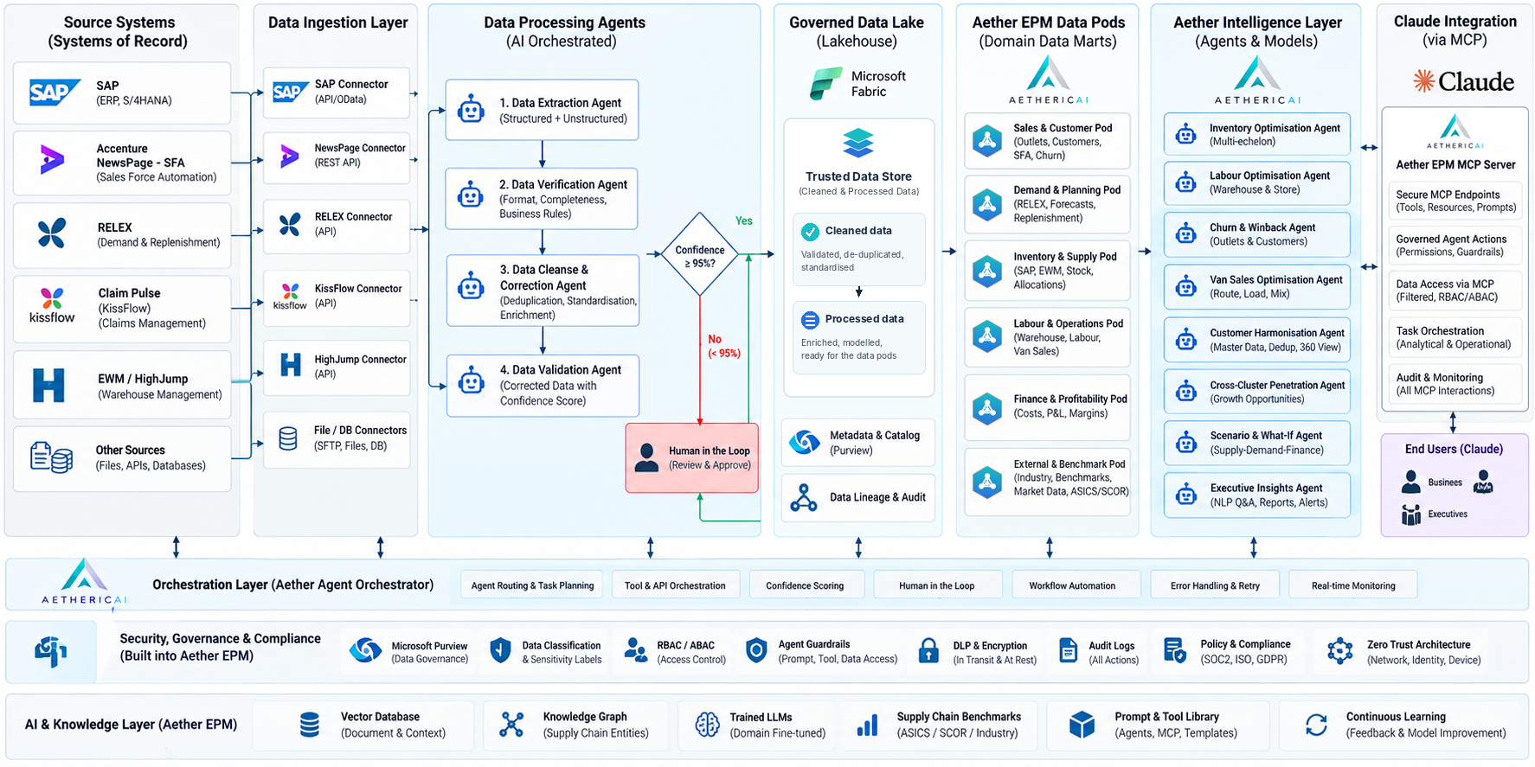

04 / PROPRIETARY ARCHITECTURE / 1 OF 2
Aether EPM enterprise architecture
Notes:
• Placeholder intentionally blank at requester’s direction. Suggested source for context only: https://aethericai.com/platform/ ; do not present this as an endorsed architecture diagram before replacement.

