Slide 1

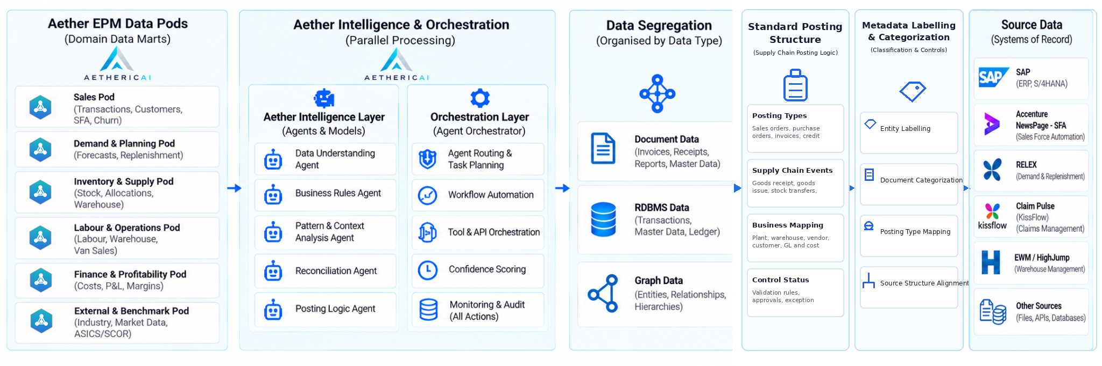

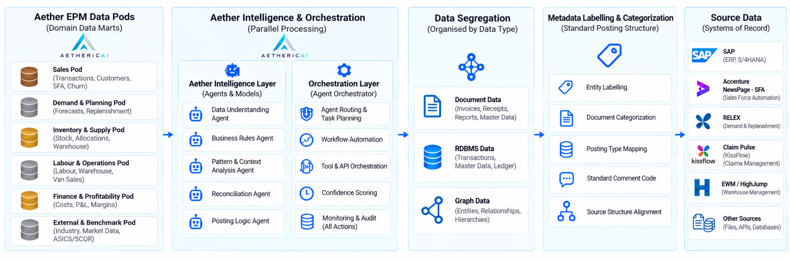
05 / PROPRIETARY ARCHITECTURE / 2 OF 2
Aether EPM intelligence & orchestration model
Original platform flow, with Standard Posting Structure integrated into the main architecture.
ARCHITECTURE UPDATE • Standard Posting Structure is integrated as a core architecture block.
05
Notes:
• Placeholder intentionally blank at requester’s direction. Current site outlines Connect, Detect, Recommend, Approve, Act: https://aethericai.com/platform/ .
• Security lifecycle in supplied reference PDF: ingest/label, retrieve/ground, reason/validate, execute/audit.

